Slide 1

Data Analysis on Televisions

Slide 2

Name: Nikhitha Pancherpula
Qualification : Bsc(Computer Science)
About Us
Name: K Naresh Yadav
Qualification : MCA

Slide 3
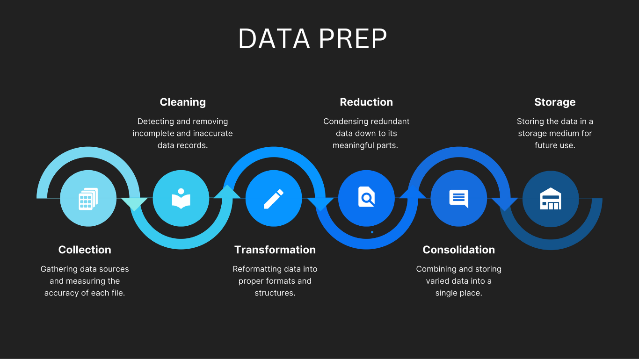
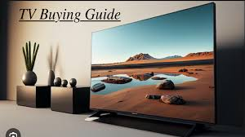
Introduction:
Problem Statement:
People want Televisions for Entertainment, information, education, connectivity, socializing, advertising and cultural influence.
To Analyse the data of Televisions and suggests a best Televisions

Slide 4
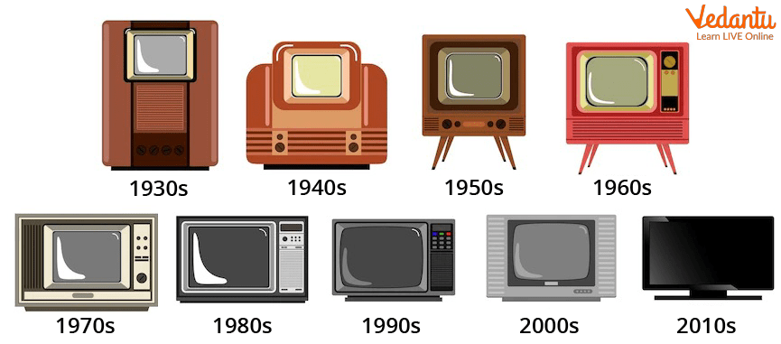
About Televisions
Philo Taylor Farnsworth invented the first Electronic television in 1927

Slide 5
Contents:
Tools
Website for web-Scrapping
Raw Data
Data Cleaning and Data Manipulation
Cleaned Data
EDA
Conclusion

Slide 6

Tools (Libraries) used:
Python
Pandas
NumPy
Matplotlib
Seaborn
BeautifulSoup

Slide 7
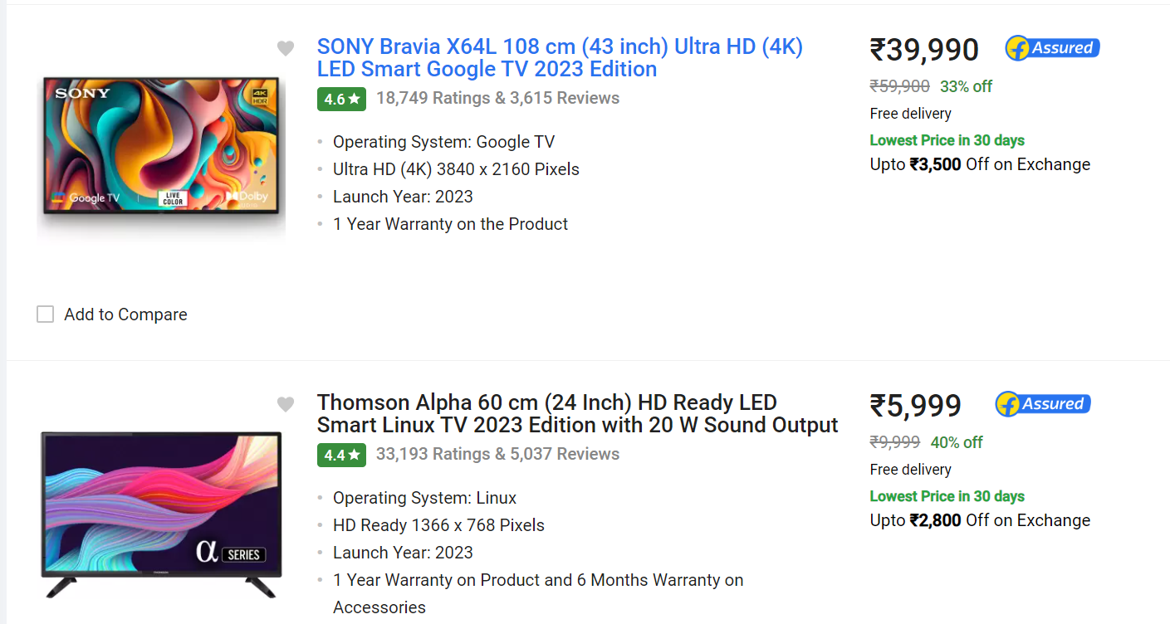
Website used for Data Analysis
Objective: Our is to gain insights into customer preference

Slide 8
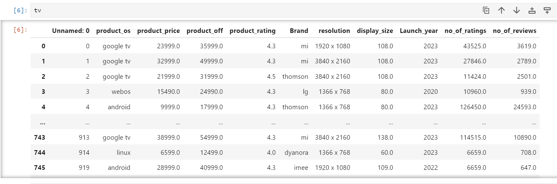
Raw data from the website

Slide 9
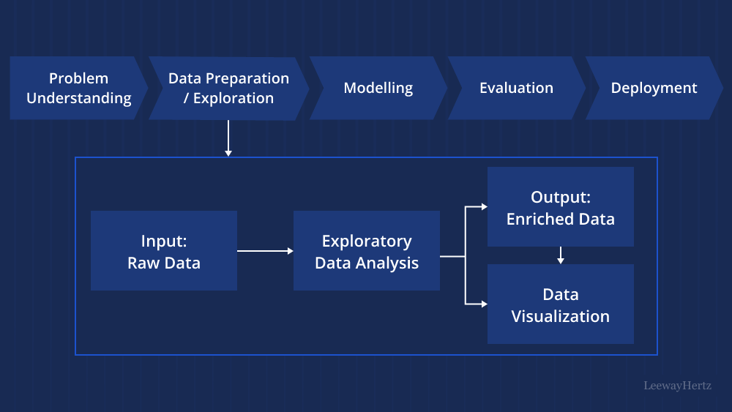
Data Cleaning Steps

Slide 10
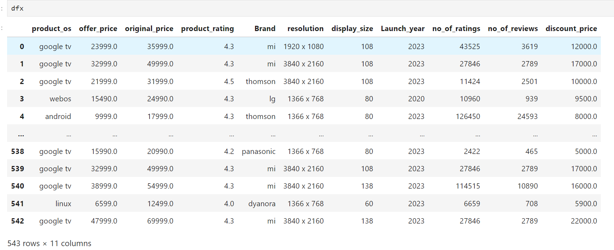
Cleaned Data Frame

Slide 11

Steps Involved In Data Analysis
Objectives Definition
Data Collection
Data Cleaning
Documentation
Exploratory Data Analysis (EDA)

Slide 12
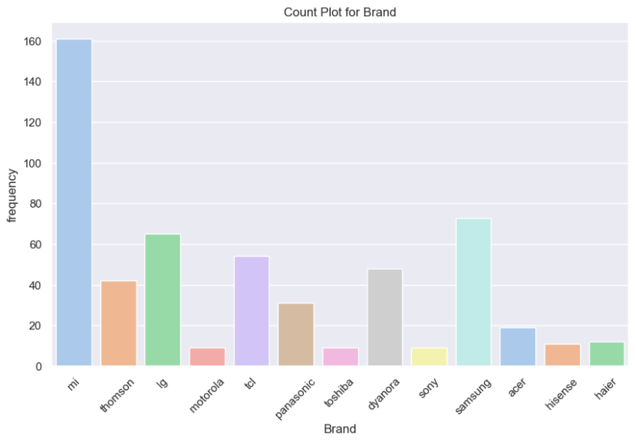
Uni variate
Count Plot for Brands
Useful when you want to show the count or sum of a numerical variable for each category.
Suitable for visualizing the frequency or total within each category.

Slide 13
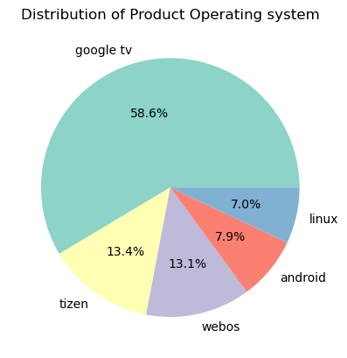
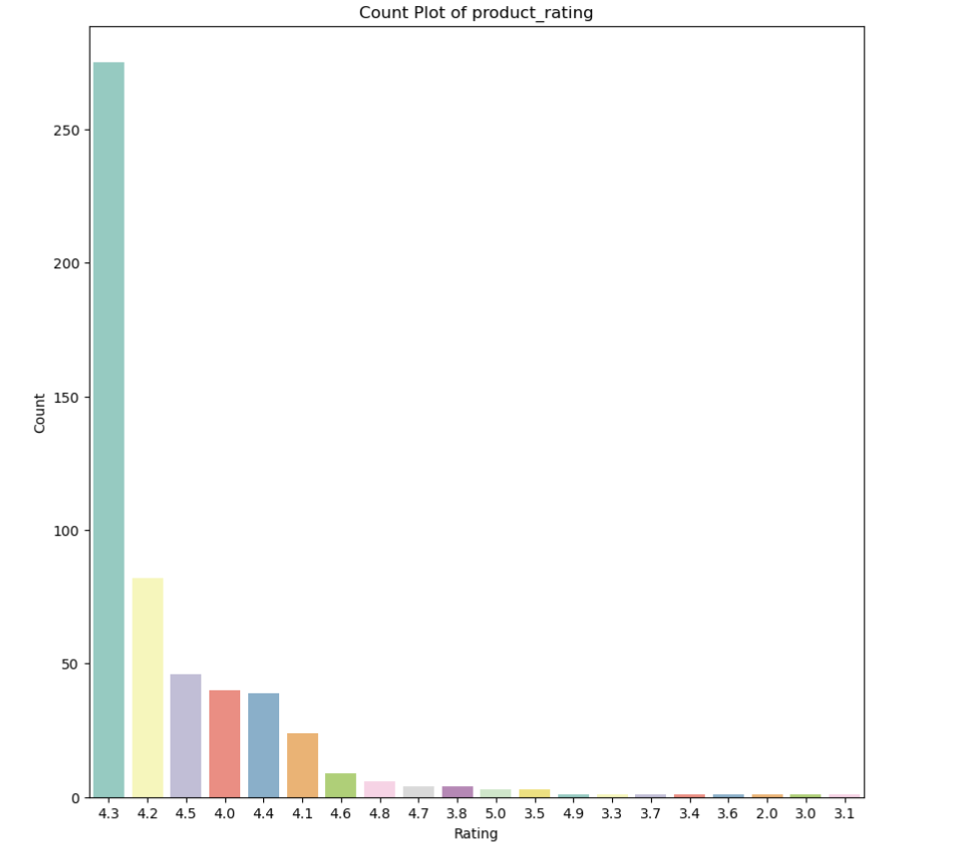
Comparison of Price & Brands using Boxplot
Ideal for the distribution of categorical variable for Operating System.
Bar Plot Provides information count of ratings.

Slide 14
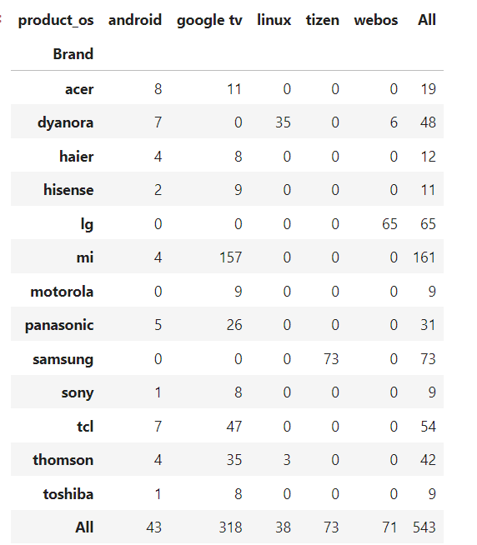
Brands Based on OS(Operating System)

Slide 15
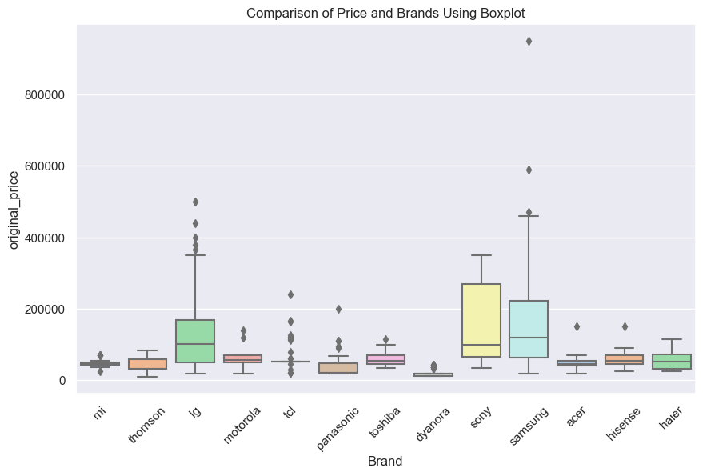
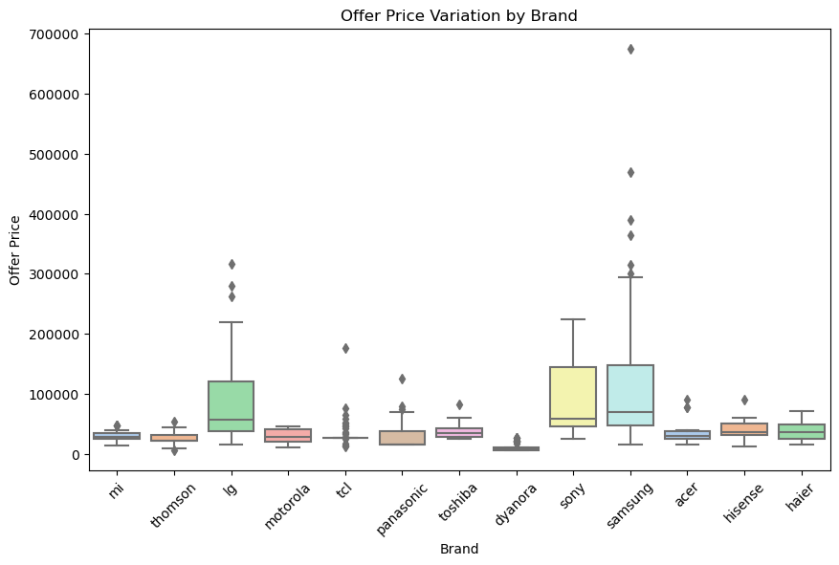
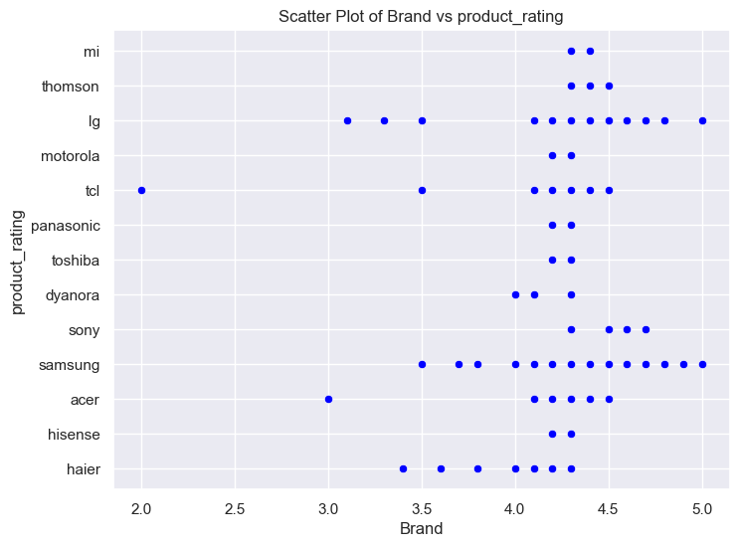
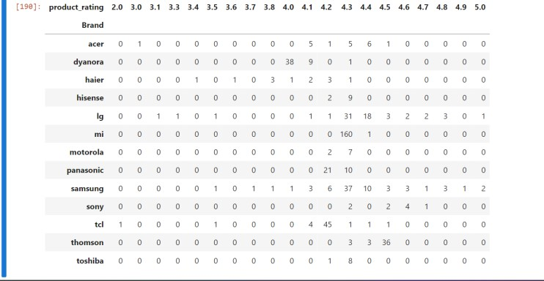
Comparison of Price & Brand using boxplot
Box Plot
Useful for visualizing the numerical vs categorical variables.
Provides information about median, and quartiles, and potential outliers

Slide 16
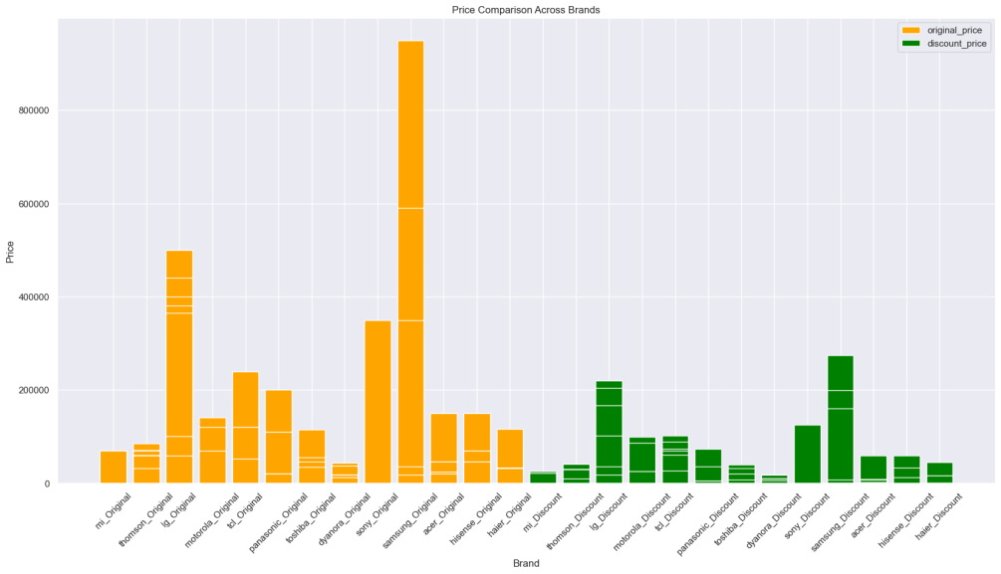
Visualizing Original-Discount Prices Patterns
Bar plot

Slide 17
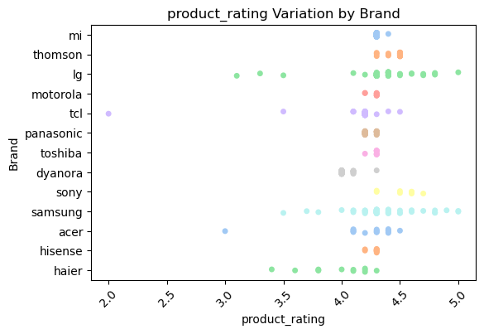
Highest Ratings & Brands
Strip Plot or Swarm Plot:
Displays individual data points along the categorical axis.
Useful for visualizing the distribution of the numerical variable for each category.

Slide 18
Conclusion
MI Brand produces Highest Number Of Products & Most Number Products Having Google Operating System
In 2023 Highest Number Of Products Launched Year
Samsung Brand Has The Highest Price Value & Thomson Brand Has The Lowest Price Value
Samsung Brand Has The Highest Discounted Product
Samsung And LG Are The Highest Ratings Brands

Slide 19

Challenges Faced
'Victory Behind The Fear'

Slide 20

THANK YOU

